Slide 1

Logstash
Utah Code Camp
Matt Smith
March 15, 2014

Slide 2

Do you feel like this as a Developer?
http://www.youtube.com/watch?v=mIEXZmoZ45U

Slide 3

How you feel when your boss is watching you debug a production bug!
https://www.youtube.com/watch?v=qqgjg1rIKAk

Slide 4
The right tool for the right job
Sniper
Surgical Weapon
Machine Gun
Tactical Weapon

Slide 5
Machine Guns
There are two ways you can fire a machine gun
Ready, Aim, Fire
Ready, Fire, Aim
Tracer Rounds
Phosphorus ignites leaving a streak of light behind the round.
1 in 5 rounds
(The Pragmatic Programmer, By Andrew Hunt and David Thomas)

Slide 6
Your first stab at logging
Console.WriteLine(“Hello world”); // C#
puts “Hello world” # Ruby
System.out.println(“Hello world”) // Java
console.log(“Hello world”) // JavaScript
PRINT “Hello world” -- SQL

Slide 7
Logger frameworks are born
Configurable outputs of log data to files,
email, dbs, etc.
Log4J - Java
Log4Net - .Net
Logger – Ruby (built in)

Slide 8
Old school logging
When you are told to go look at the logs
cat, tail, grep, sed, awk, …..
regular expressions
Login to each server
Look at all the logs
Try doing that with someone sitting over your shoulder

Slide 9
What time is it?
1304060505
29/Apr/2011:07:05:26 +0000
Fri, 21 Nov 1997 09:55:06 -0600
Oct 11 20:21:47
020805 13:51:24
110429.071055,118
@4000000037c219bf2ef02e94

Slide 10
Does not scale
More than one server
Many sources within any given server
Different time zones for different servers

Slide 11
System Logs
Consolidate log entries to single location
Now, the problem turns from too little information to one of too much information and too little context
Not everything logs to the system log

Slide 12
Logstash
Open Source Centralized Logging Manager
Apache 2.0 License
Written by @jordansissel
Currently works at ElasticSearch

Slide 13
What does Logstash do?
Ships logs from any source
Parse them
Get the right timestamp
Index them
Allows you to search them

Slide 14
How does Logstash get the logs
TCP/UDP
Files
Syslog
Microsoft Windows EventLogs
STDIN
Websocket
zeromq
Plus many more
And it’s extensible (you can write your own)

Slide 15
Parse the input
Json
Csv
Xml
Multi-line (Stack traces from file input)
Regex
Grok (Regex on steroids)

Slide 16
Architecture
Indexer Search & Storage Web UI
Application
Application

Slide 17
Architecture
Web Interface
Storage & Search
Indexer
Broker
Shipper
Shipper
Broker
Shipper
Shipper
Indexer
Broker
Shipper
Shipper

Slide 18
How can Logstash output data
TCP/UDP
Email
Files
HTTP
Nagios (IT Infrastructure Monitoring tool)
Alerting tools (Hipchat, SMS)
Graphing suites (StatsD, Graphite)

Slide 19
Logstash @ Dreamhost
20k apache events/sec peak
250 million events/day
75gb data/day
160 web servers
7 logstash/elasticsearch servers

Slide 20
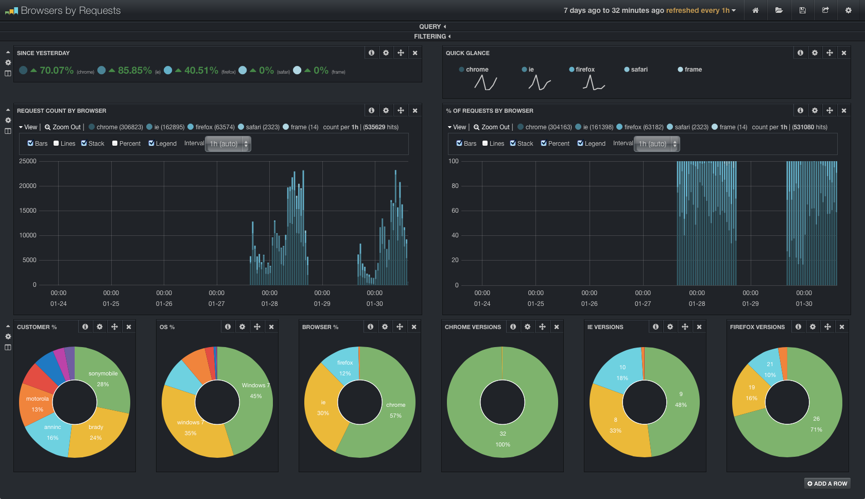

Slide 21
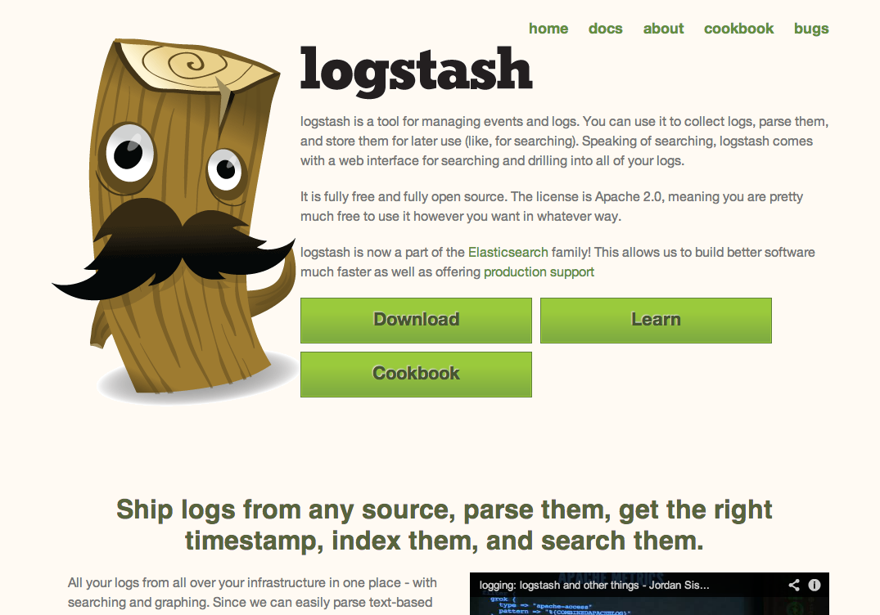
How do you implement it
Go to http://logstash.net

Slide 22
Resources
http://logstash.net
http://www.logstashbook.com ($9.99)
http://github.com/logstash
logstash-users@googlegroups.com
logstash.jira.com
Google
This presentation (slides and example app) https://github.com/mtscout6/my-presentations/tree/master/Logstash

